Slide 1
Volunteered Geographic Information
GEOG: 372 Web Mapping
Bo Zhao
Oregon State University

Slide 2
The Development of GIS (so far)
1962-1992: GIS – S for Systems (Roger Tomlinson)
1992-2012: GIS – S for Science (Michael Goodchild)
2012-2017(?): GIS - S for a combinations of Systems, Science, Services, Studies, .....
Notes:
For all these emerging topics, or competing visions,

Slide 3
Competing Visions: The next generation of GIS?
Next Generation of Digital Earth (Goodchild et al.)
Spatial Computing (Duckham/Shekhar)
Open GIS (MSC)
CyberGIS (Wang/Anselin/Nyerges)
GIS as a Platform (Dangermond)
GIS 2.0/3.0 (Yuan/Tsou)
Qualitative GIS (Elwood/Cope)
Volumteered Geographic Information (Goodchild/Sui/Elwood)
People-based GIS /Big-time Geography (Miller)
CloudGIS (Yang)
Post-GIS (Wright/Harvey)
Metaverse
GIS as Media
Semantic GeoWeb
MetaGIS
Quantum GIS
........

Slide 4
Introduction
VGI
Volunteered Geographic Information
Social interaction
Web 2.0
Updating
with local knowledge
New Data
from local knowledge

Slide 5

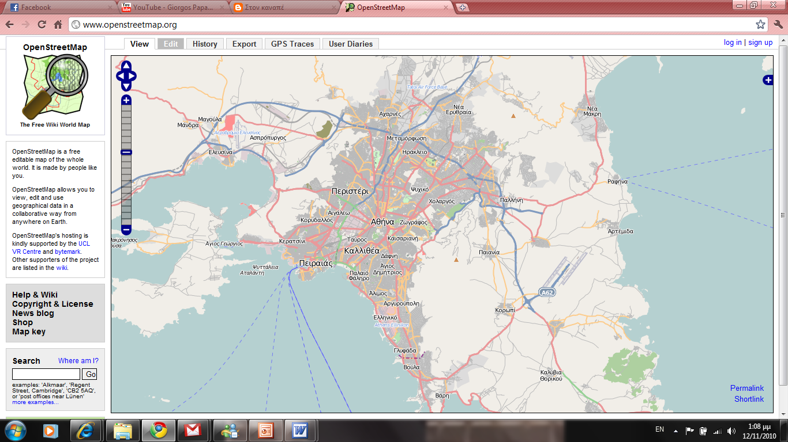
THE OPENSTREETMAP - GENERAL
As the welcome message says in the main home page of OSM:“The OpenStreetMap is a free, editable map of the whole world. It is made by people like you.”
OSM was launched by Steve Coast in 2004 and was spread in many countries in relatively short time.
Guardian introduced OSΜ in its top 5 list among 100 mapping related websites in 2009.

Slide 6
THE OPENSTREETMAP IN HAITI
Most quality studies were focused on navigation aspects testing the accuracy of spatial data for routing.
However Haiti example changed the way that OpenStreetMap can be used.
Haiti was dramatically affected after the earthquake hit in January 12 the capital city of Port-au-Prince.
48 hours spent to get first imagery loaded on the OSM platform available for tracing. (Maron, 2010)
60 persons were trained and more that 700 contributed in mapping, among them people from UN agencies, NGOs, National Haitian Mapping Agency, National Center of Spatial Information and Haitian civil society. (Waters, 2010)

Slide 7
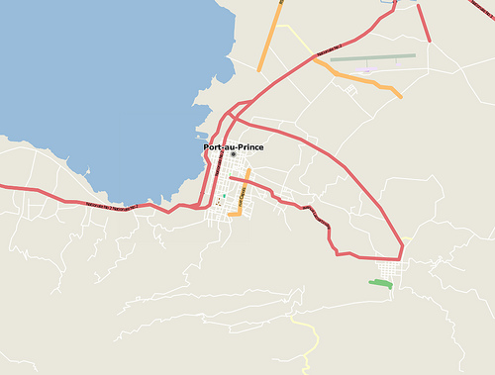
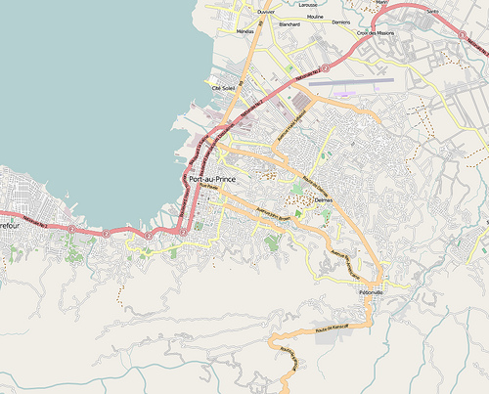
THE OPENSTREETMAP IN HAITI
Day 0
Day 2
http://brainoff.com/weblog/2010/01/14/1518

Slide 8
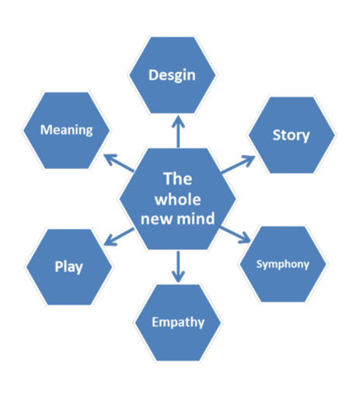

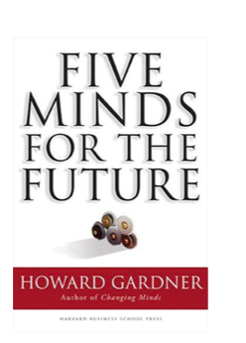
A Whole New Mind
Notes:
In order to help us to organize this lecture, we are inspired by Daniel Pink’s a who new mind
Daniel Pink outlines our mind by six essential senses
Design – Moving beyond function to engage the sense.
Story – Narrative added to products and services - not just argument. Best of the six senses.
Symphony – Adding invention and big picture thinking (not just detail focus).
Empathy – Going beyond logic and engaging emotion and intuition.
Play – Bringing humor and light-heartedness to business and products.
Meaning – the purpose is the journey, give meaning to life from inside yourself.

Slide 9
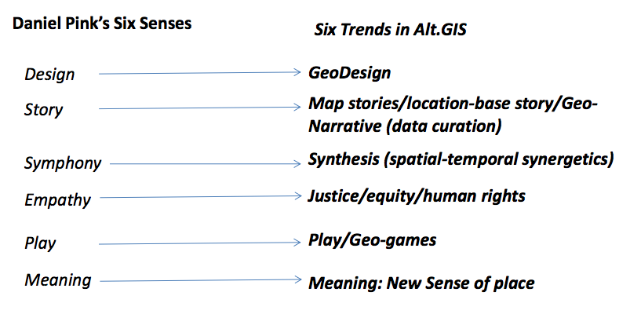
Understanding alt.gis via the whole new mind:

Slide 10


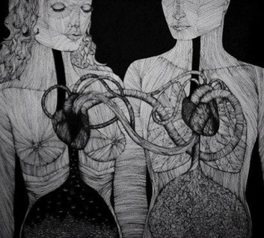
Empathy· VGI

Slide 11
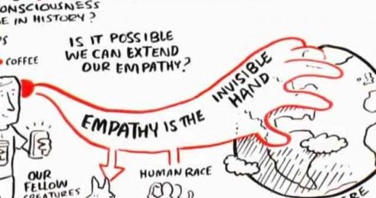
Metaphors
A fountain or spring flowing freely
Strings tuned to the same frequency.
Standing in someone else's shoes.
Looking through someone else's eyes
http://www.kindredcommunity.com/2013/12/10020/
A warm handshake is as important as the invisible hand of the market in order to make the whole economic system work with a higher purpose and meaning. (Adam Smith)

Slide 12
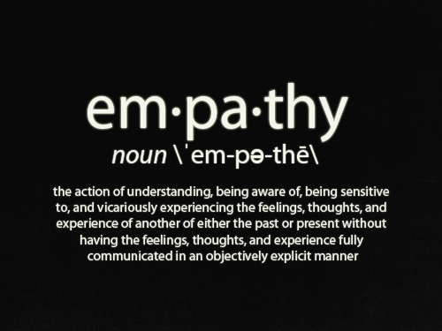
http://www.stuartduncan.name/general/autism-and-empathy-heres-another-way-to-look-at-it/
Notes:
The ability to understand and share the feelings of another.

Slide 13
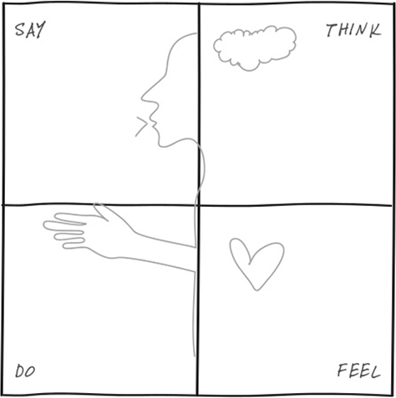
Empathy Map
A Empathy Map can help tee up a discussion about the needs a user has. The discussion will be centered around what was observed, and what can be inferred about these user groups’ beliefs and emotions.
http://www.uxmatters.com/mt/archives/2014/02/conference-review-ux-strat-2013-part-2-day-1.php

Slide 14
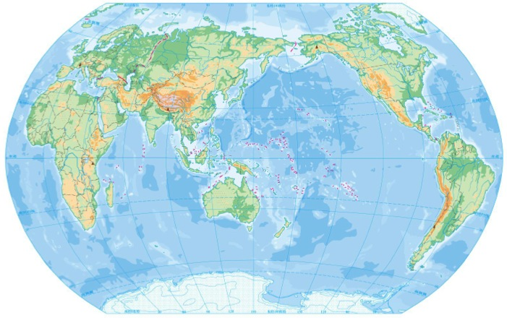
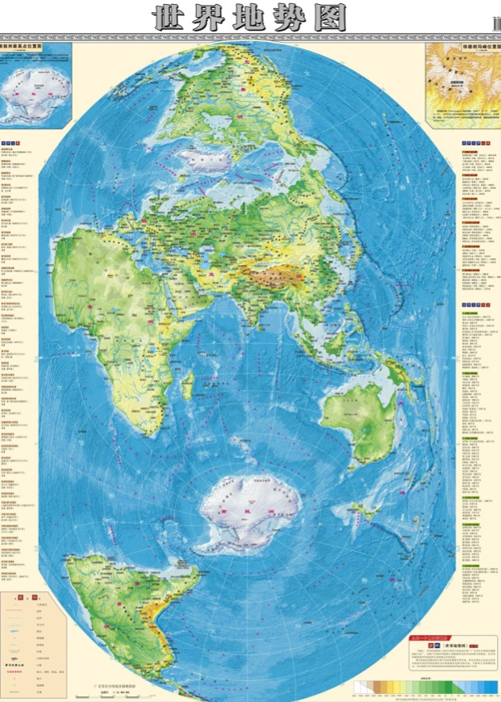
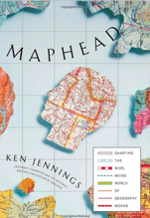
Cartophilla
The love of maps.
Jennings, K. (2012). Maphead: Charting the Wide, Weird World of Geography Wonks. Simon and Schuster.
http://news.163.com/13/1011/16/9ATV183R00014AEE.html?f=jsearch
http://mil.cssn.cn/jsx/jsfsy_jsx/201401/t20140102_933999.shtml

Slide 15
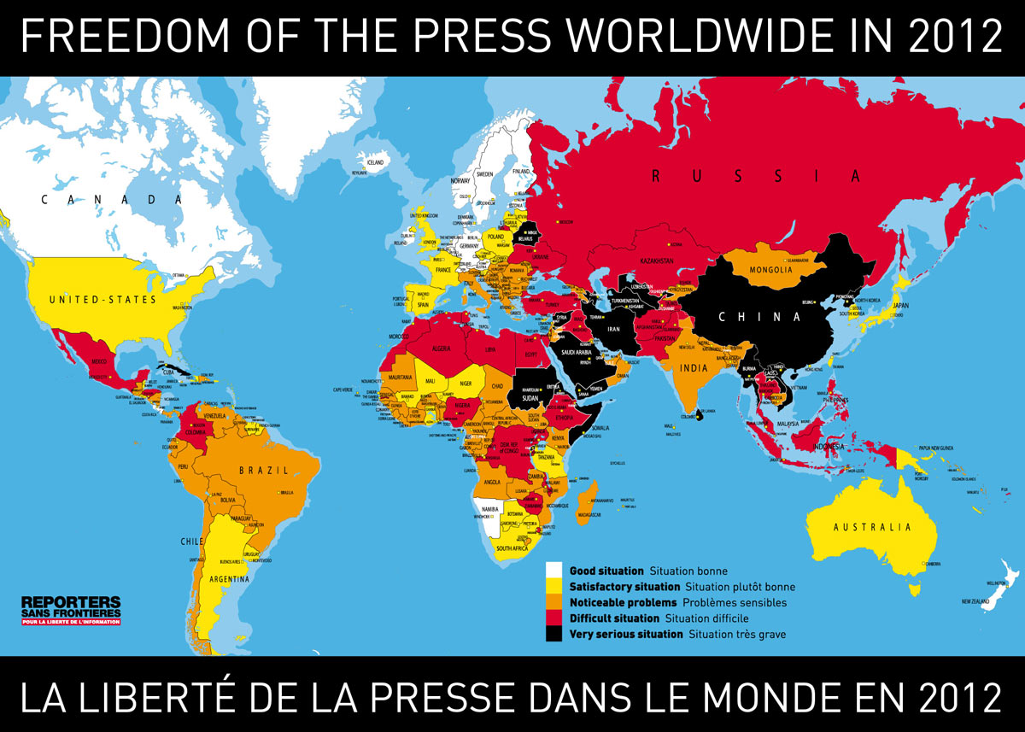
Worldwide situation of countries according to their respect for press freedom, as provided in the Press Freedom Index by Reporters sans frontières/Reporters without borders. (http://www.nationsonline.org/oneworld/map/press_freedom_map.htm)

Slide 16
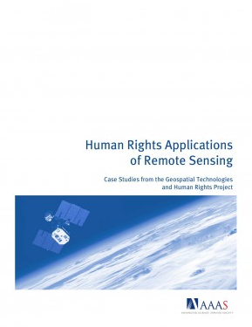
Techniques
In the 19th century, the long important schools of cartography and mapmaking were joined by aerial photography as early cameras were sent aloft on balloons and pigeons, and then on airplanes during the 20th century. The science and art of photographic interpretation and map making was accelerated during the Second World War and during the Cold War it took on new dimensions with the advent of satellites and computers.
Satellites allowed images of the Earth’s surface and human activities therein with certain limitations. Computers allowed storage and transfer of imagery together with the development of associated digital software, maps, and data sets on socioeconomic and environmental phenomena, collectively called geographic information systems (GIS).
What kind of VGIs are available or in use for moving critical GIS from dense theoretical discussions into meaningful practices?
http://www.aaas.org/report/human-rights-applications-remote-sensing

Slide 17
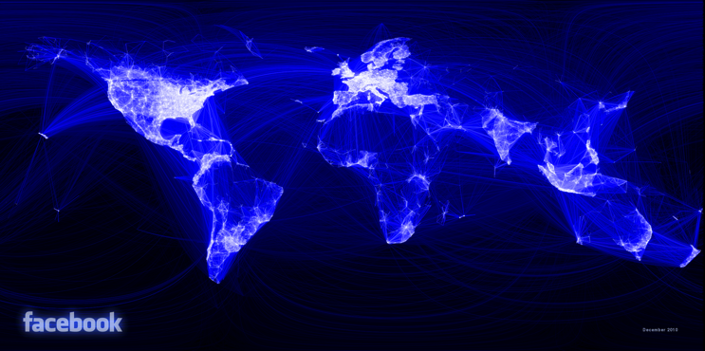
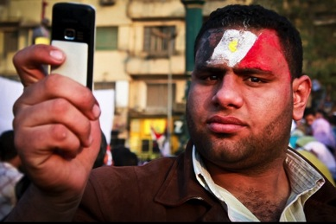

Volunteered Geographic Information, VGI
the Arab spring, social media, e.g. Facebook, twitter
Notes:
多图

Slide 18
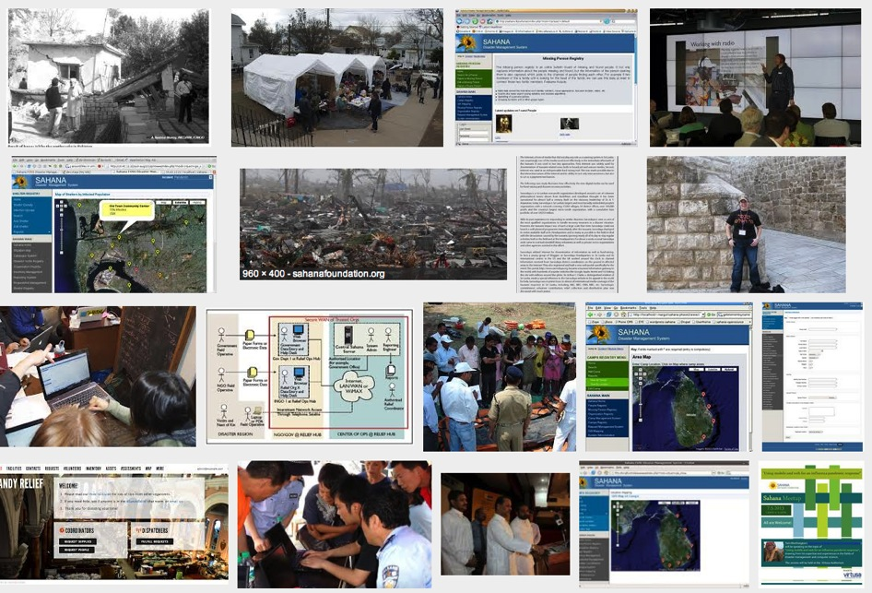
Sahana – Disaster Management System
Tsunami -- Web mapping for VGI
Notes:
多图

Slide 19
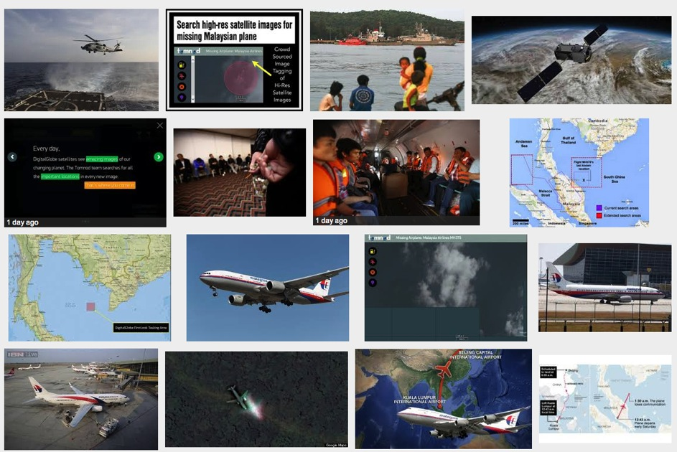
VGI - Digital Globe
Malaysian Missing Airplane MH370
http://www.tomnod.com/nod/challenge/malaysiaairsar2014
Notes:
多图

Slide 20
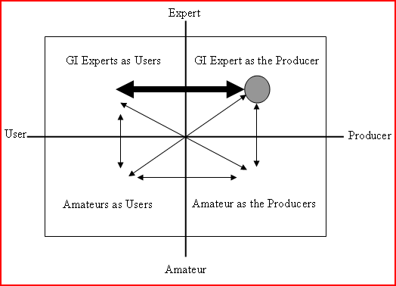
VGI and its implications
Budhathoki et. al (2008)

Slide 21
Participants
Government
Individuals (Volunteers)
Professional
Non-Professional
Close
Open
Governments, Organizations (companies, NGOs, etc.) and Individuals.
Geotech itself is undergoing a course of power shift.

Slide 22
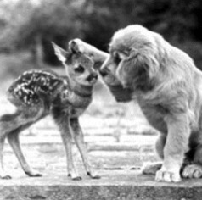

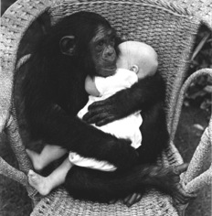
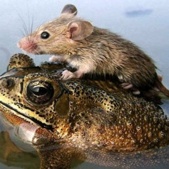
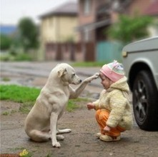
Empowering the powerless
Who is the powerless, and how to empowering with VGI?
Ethnic minorities, women, not straights, disables, children, animals.

Slide 23
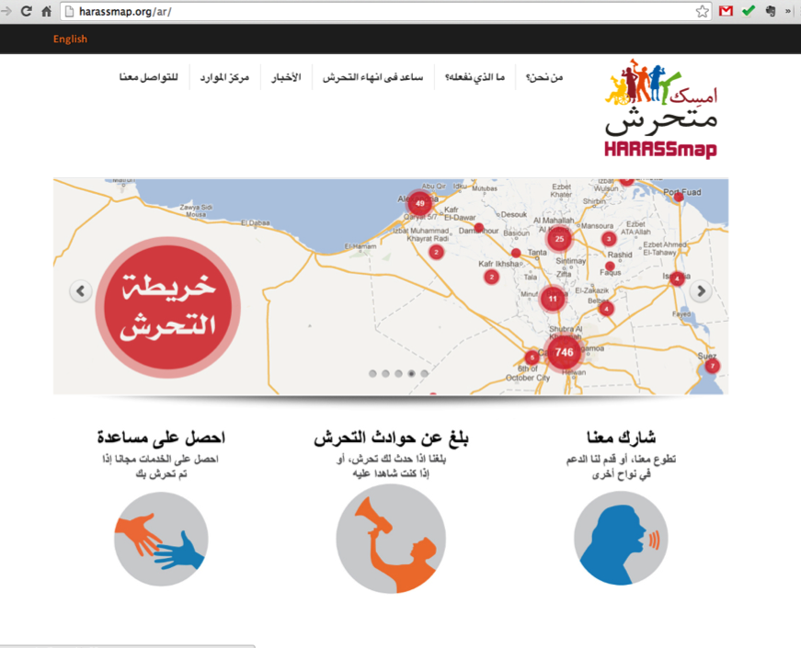
Women
http://harassmap.org/ar/

Slide 24
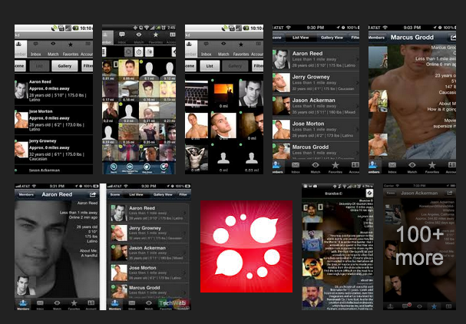
Not Straights – Jack’d, Brenda, Bender
https://play.google.com/store/search?q=gay,lesbian&c=apps

Slide 25
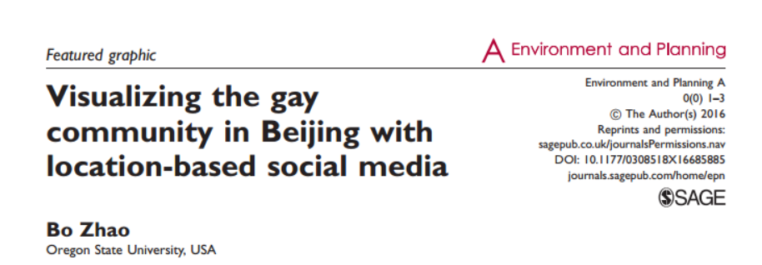
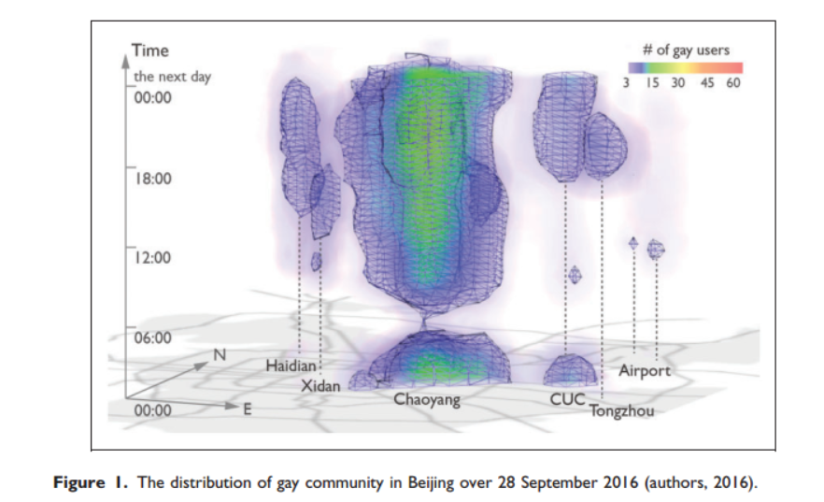

Slide 26
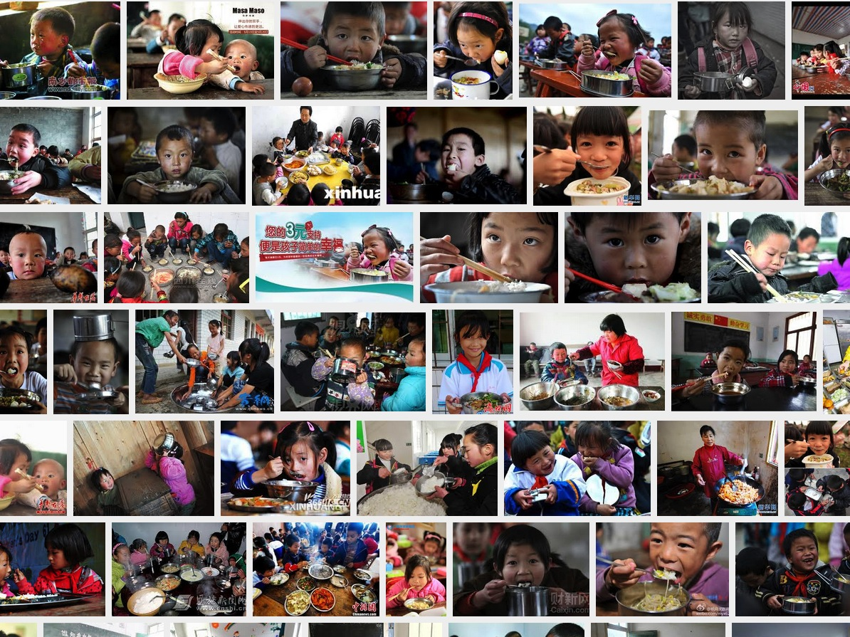

Slide 27
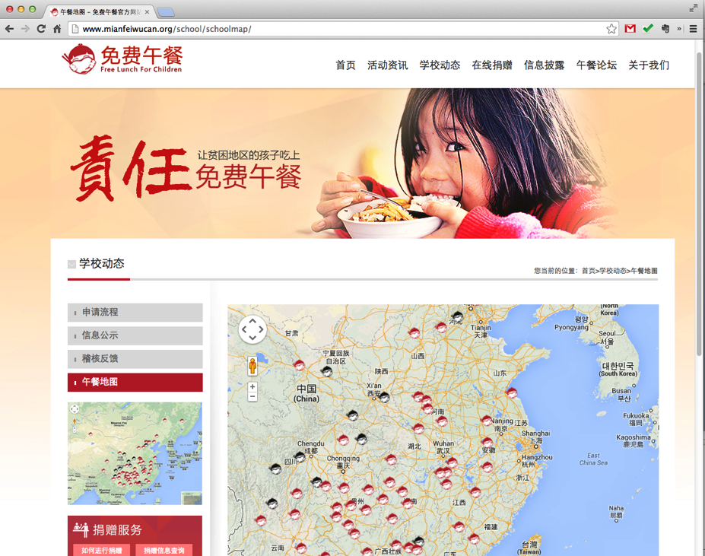
Free Lunch for Children
http://www.mianfeiwucan.org/school/schoolmap/

Slide 28
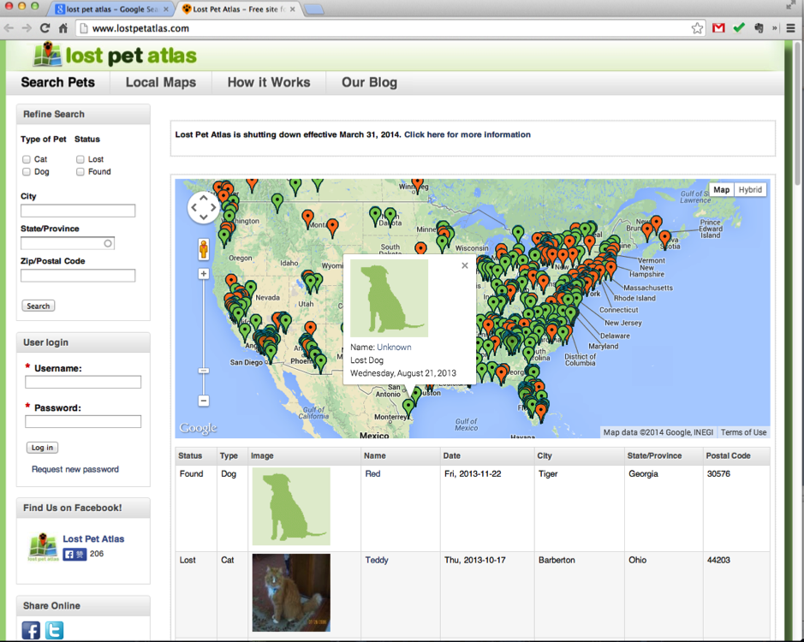
Animals – Lost pet Atlas
http://www.lostpetatlas.com/

Slide 29
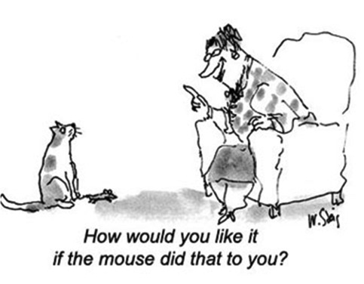
Love and pain
Protect the Human Rights?
Digital Divide
Murphy’s Law: Information is usually the least available where it is most needed.
Technology is always a double-edged sword.

Slide 30

Empathy to our own body!

